Slide 1

Capstone Project-1
Play Store App review analysis
Member
Sourabh Pramanik

Slide 2
Contents
Problem Statement
Data Summary
Dependent Variable
Independent Variable
Data cleaning
Data Visualization
Challenges
Conclusion
Q&A

Slide 3
Problem Statement
Here in this project we have two datasets-
Play Store App Data
User Review Data
In today’s world there are lots of number of applications present in Play Store.
In this project we will try find some conclusion like The popularity of applications, The type of applications developers should develop etc.

Slide 4
Data Summary
This project contains two Datasets-
Play Store Dataset 2. User Review Dataset
We will complete this project by using following steps-
After reading the data we will do the Data Cleaning operation.
We will perform the some statistical operation on our dataset.
We will do the exploratory analysis and data visualization.
After all the analysis we will come to the conclusion.

Slide 5
Data Summary
Outcomes of this Project -
Installation of application by users according to the categories.
The mostly demanded applications in playstore.
Factors which affect the installation of application by the user.

Slide 6
Dependent Variables
Play store csv file -
Category
Ratings
Reviews
Size
Type
price

Slide 7
Dependent Variables
User review csv file -
Sentiment
Sentiment Subjectivity

Slide 8
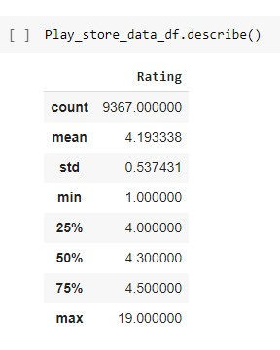
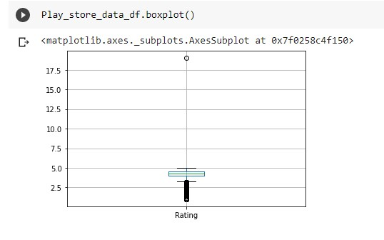
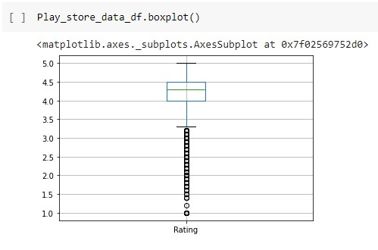
Data Cleaning
Ratings

Slide 9
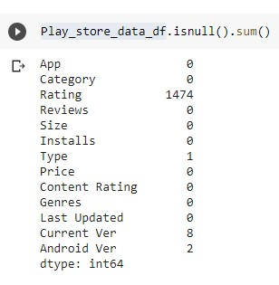
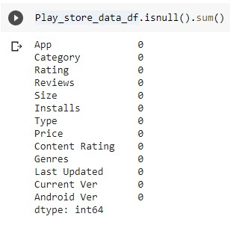
Data Cleaning
Null Values

Slide 10
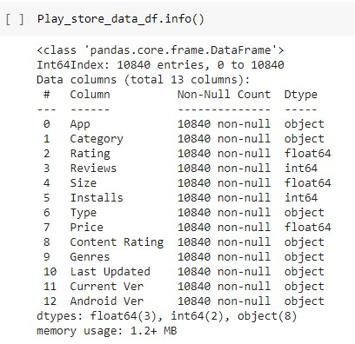
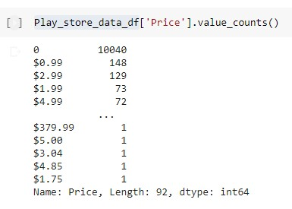
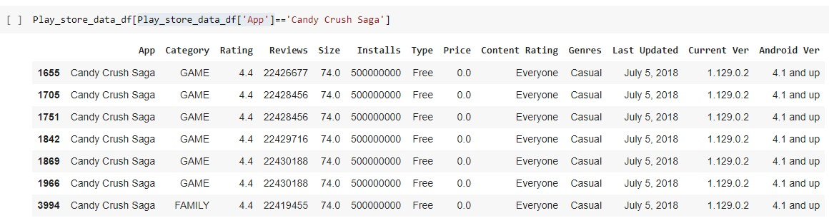
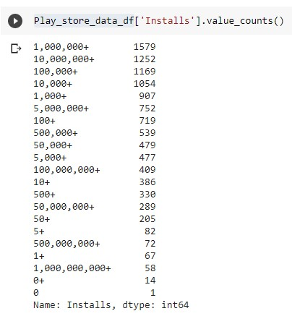
Data Cleaning
Removal of duplicate Data
Special Symbols

Slide 11
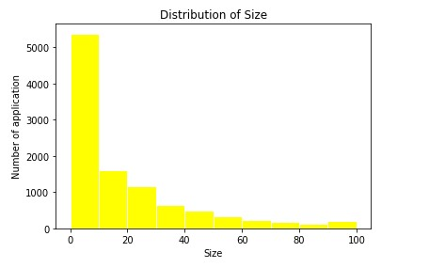
Data Visualization
Most of the application’s size between 0 to 40.
Apps according to size

Slide 12
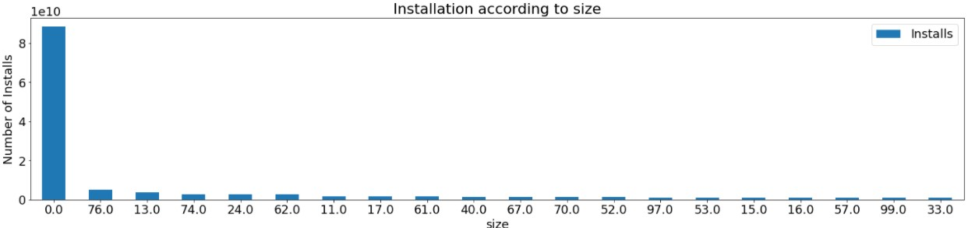
Data Visualization
According to the previous data we can see that most of the applications installed are of small sized application.
Apps installation according to size -

Slide 13
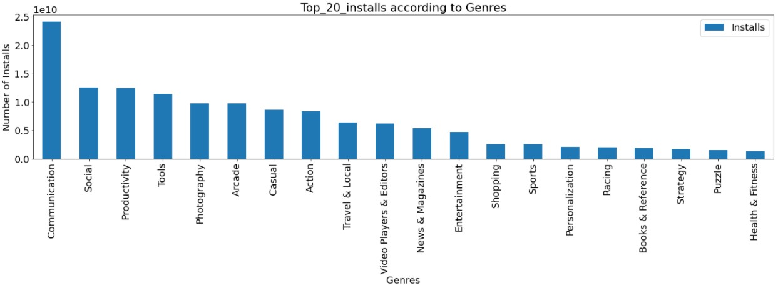
Data Visualization
The most popular applications are under communication genres
Apps installation according to Genres -

Slide 14
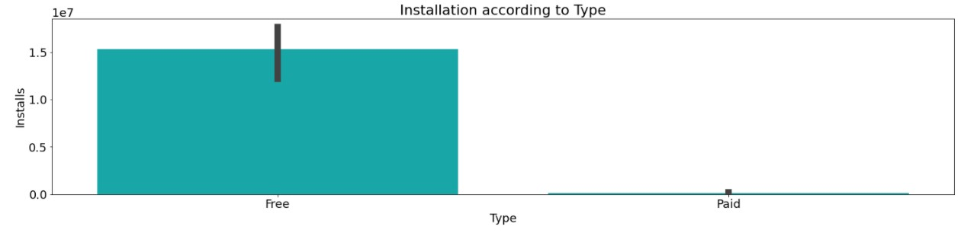
Data Visualization
Apps installation according to Type -
Free applications installation graph is high.

Slide 15
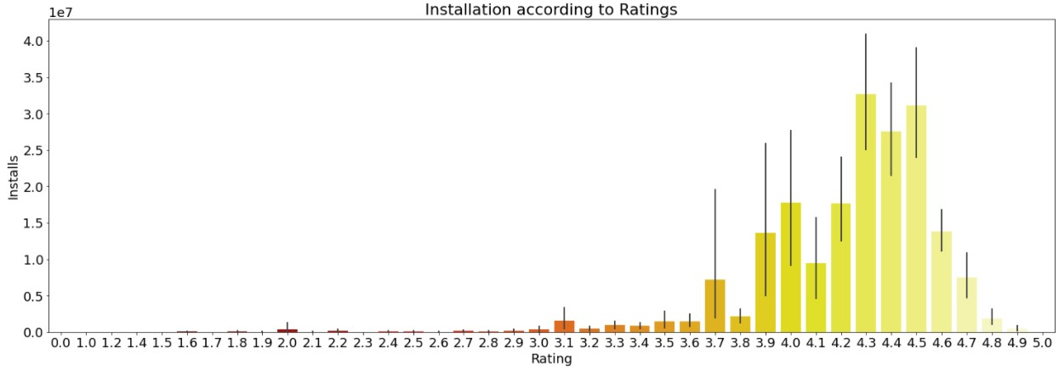
Data Visualization
User prefer the highest rating applications
Apps installation according to Rating -

Slide 16
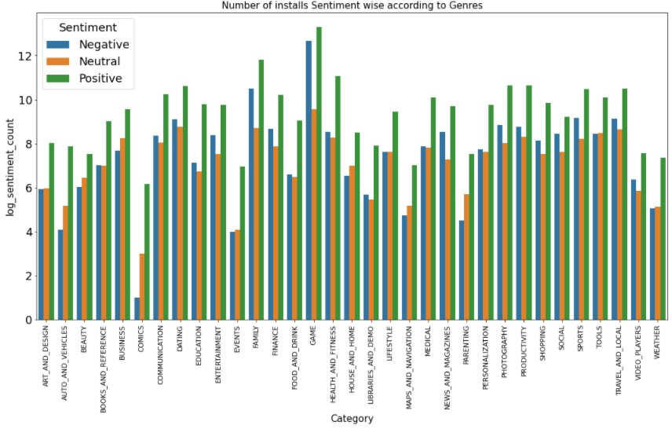
Data Visualization
Types of reviews category wise -

Slide 17
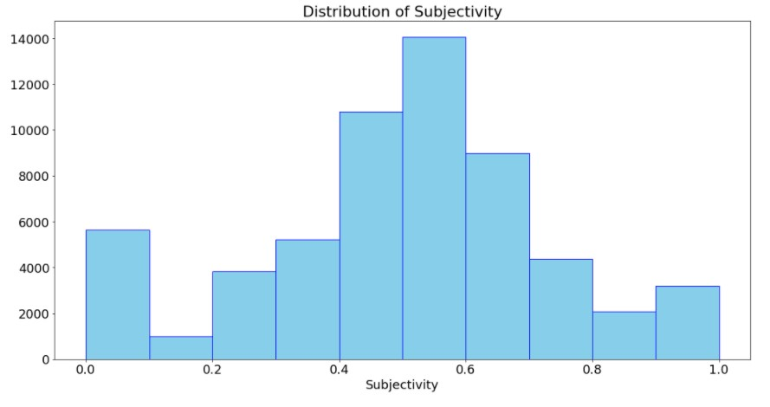
Data Visualization
Subjectivity - Personal opinion of the user about the application

Slide 18
Challenges
Cleaning the null values from the dataset.
Understanding the sentiments of the user age wise.
Difference between installing the application and usage of the installed application.

Slide 19
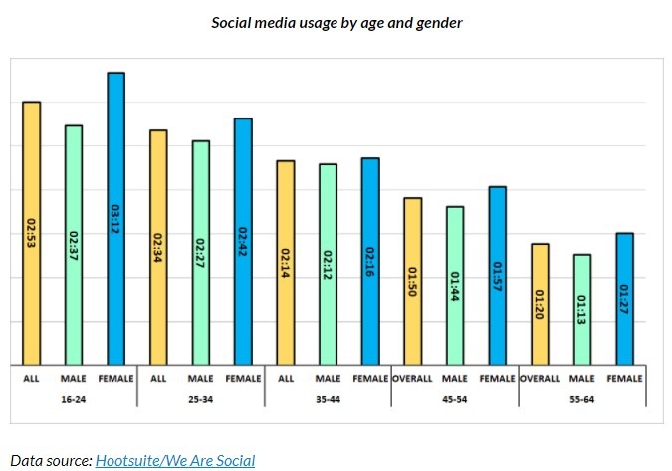
Conclusion
Users prefer to install free applications more.
Communication category apps are in high demand for all type of users. ( Source - External sources)
A part of our population ( 18-30 yr age people) use Gaming category applications a lot and give reviews according to their Sentiments. So developers have to keep proper attention while developing those apps or making change.
Users installs the application depends according to previous rating and reviews.

Slide 20
References
https://seaborn.pydata.org/examples/index.html
https://matplotlib.org/3.1.1/index.html

Slide 21
Q & A

